Slide 1

Analyzing SpaceX Rocket Data
By Adil

Slide 2

we want:
Predict will first stage land or not depends on rocket characteristics

Slide 3
In this project we will:
Collect data using APIs and Web Scraping
Process data
Apply EDA (Exploratory Data Analysis) using SQL, python and visualization techniques
Create interactive Visual Analitycs and Dashboard
Finally apply machine learning algorithms to predict will rocket land or not

Slide 4
Collecting and processing Data
SpaceX provides their API (https://api.spacexdata.com) for getting access to data, data about all launches, its outcomes and characteristics of a rocket
We will observe only one Booster Version, most succesful one, and that is Falcon 9
After connecting to the SpaceX API and using `pd.json_normalize` function we get dataset which contains unusual data

Slide 5
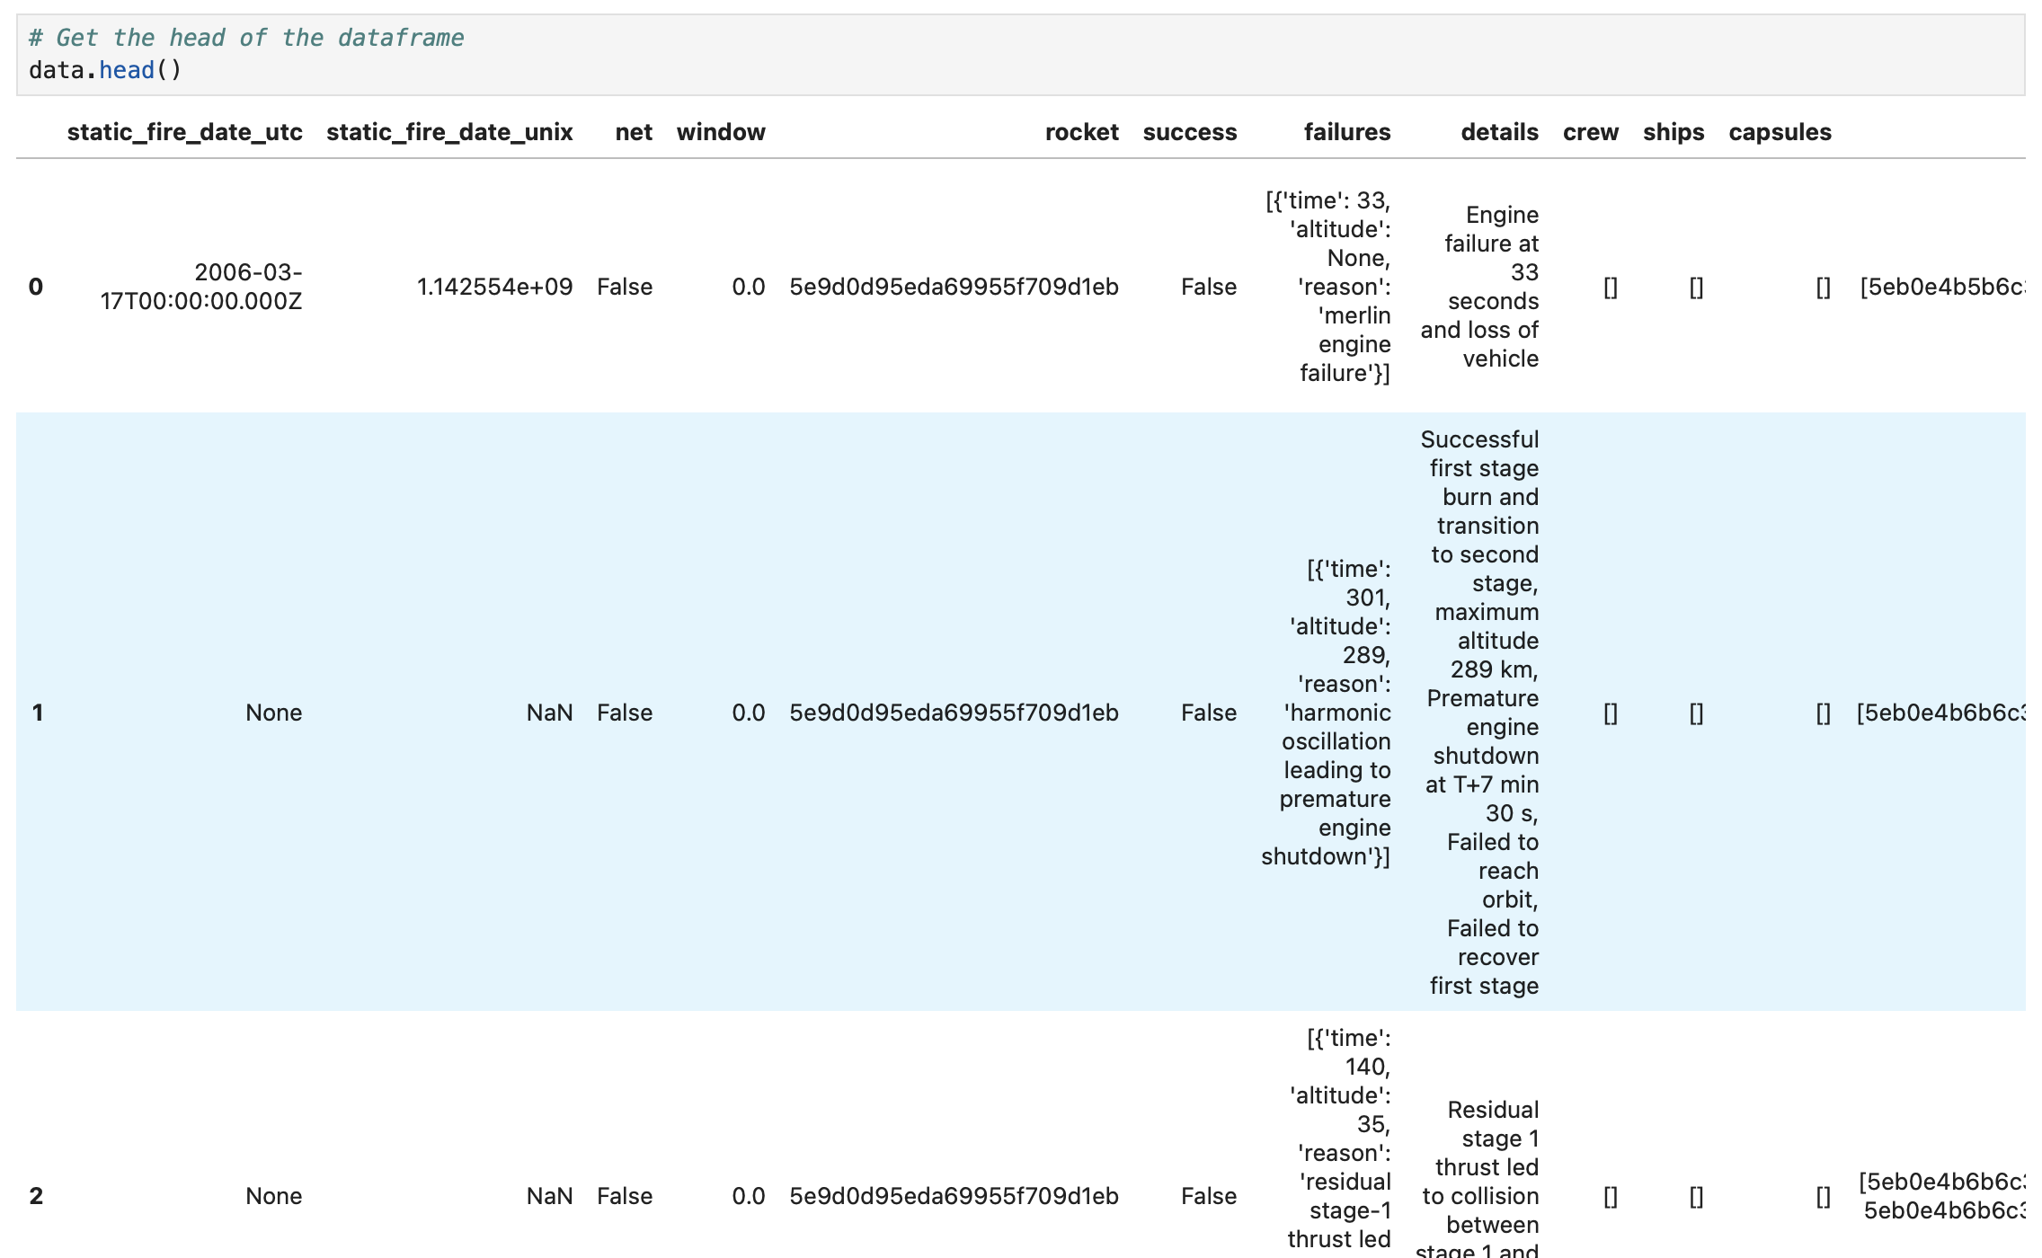
How data looks like
We can see that rocket column contain string, that string is link to table with data about certain rocket
In dataset there is a lot of that type of links
We need to extract data from links and collect them in one dataset

Slide 6
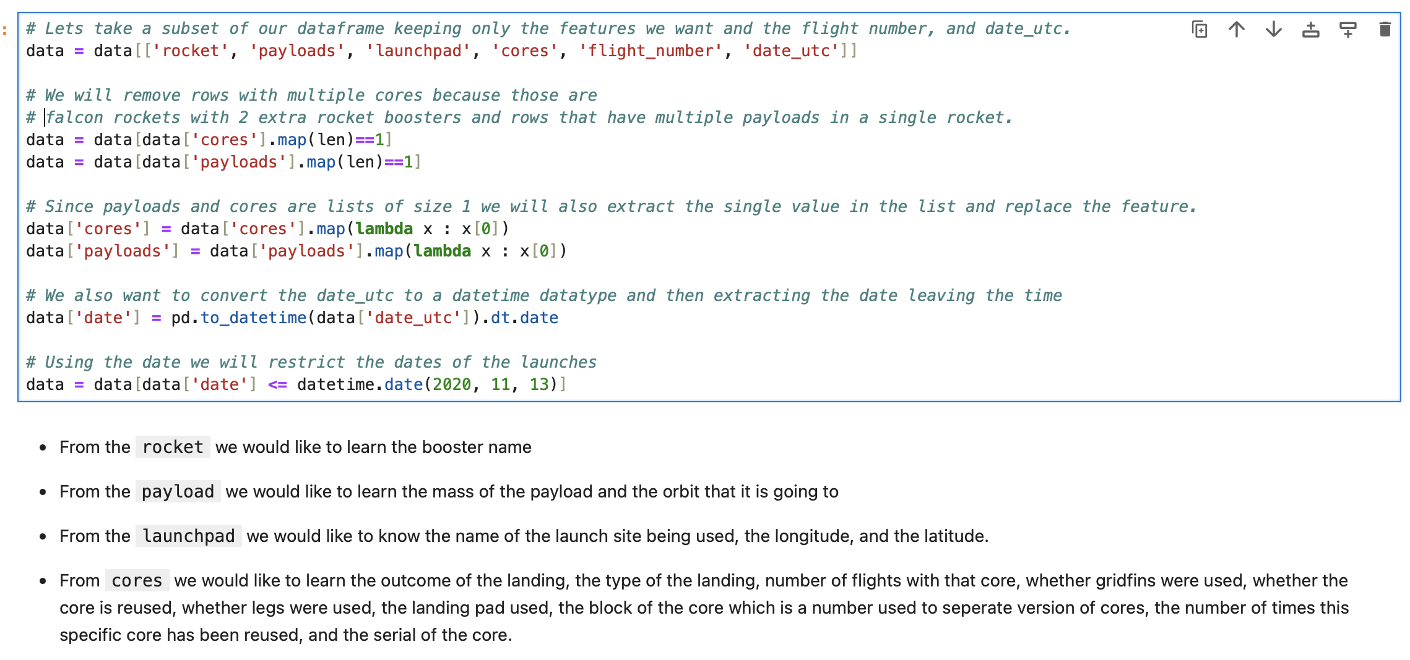
Filtering and cleaning

Slide 7
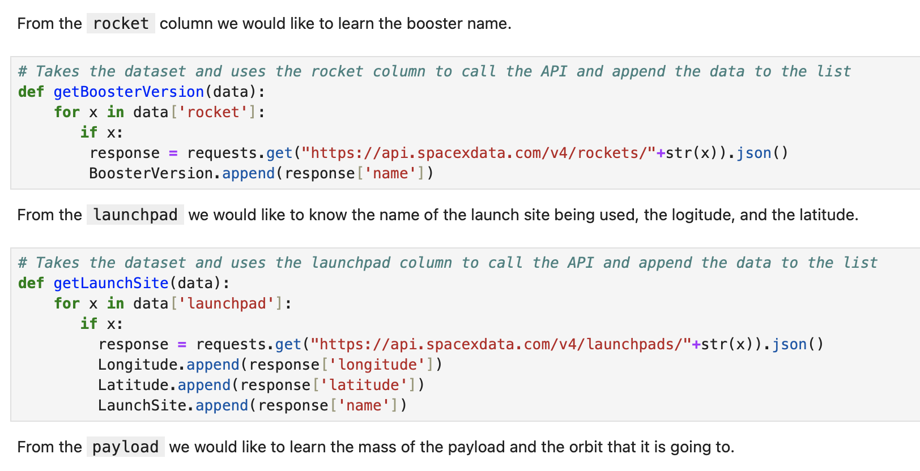
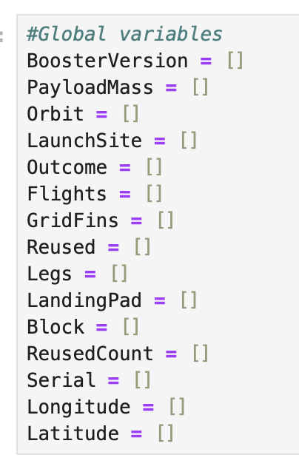
Functions to extract data from links
Some few functions as example how we extract data from links

Slide 8
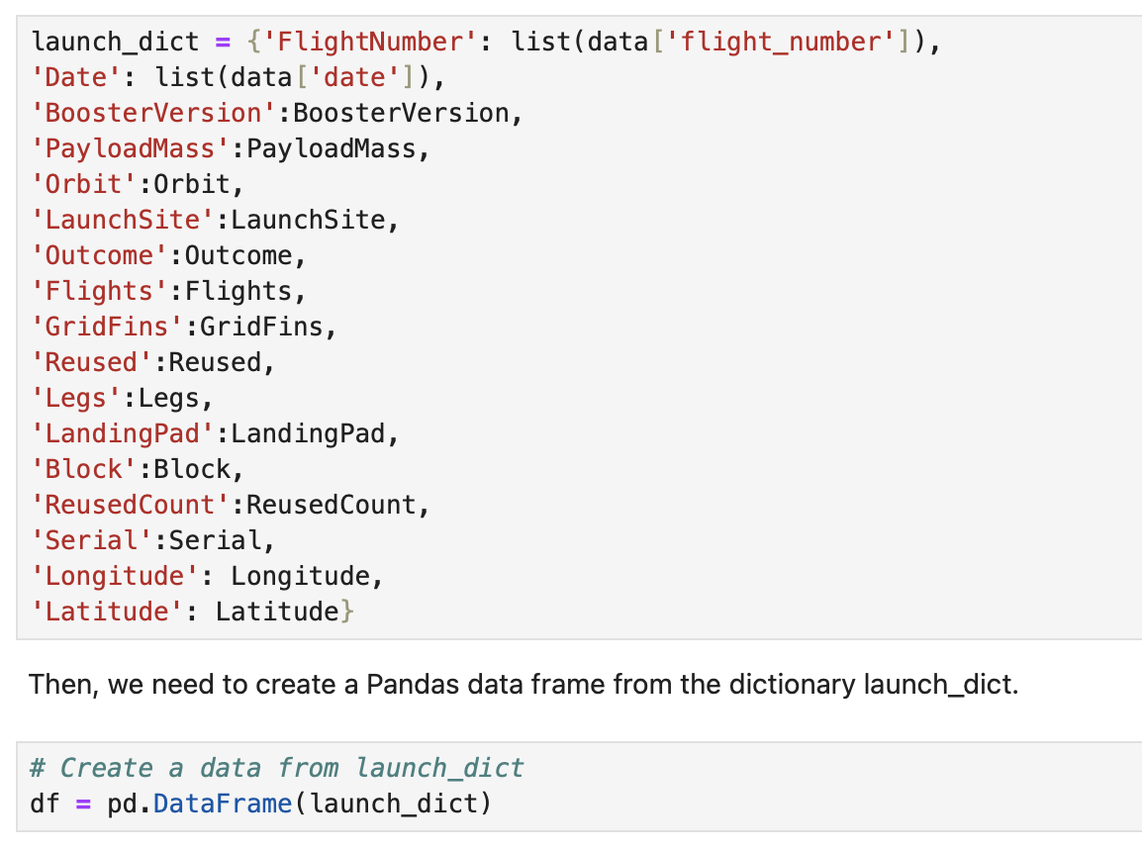
Create dataframe with whole data we needed
After that we will filter df to get data only about Falcon 9 and replace missing data with mean values

Slide 9
Collecting and Porcessing data
Also we can use websraping, and wikipedia (https://en.wikipedia.org/w/index.php?title=List_of_Falcon_9_and_Falcon_Heavy_launches&oldid=1027686922) as data source
In wikipedia data already prepared and don’t need to be precessed
As always using bs4 for webscraping, same steps for collecting we get usefull dataset
That is boring lets go forward
If some one have interest about how everything is done using webscraping, can looks to my github

Slide 10
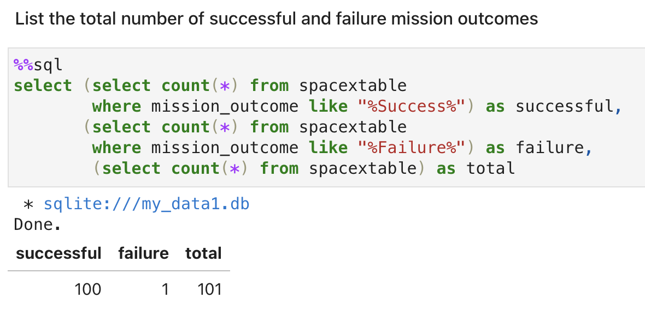
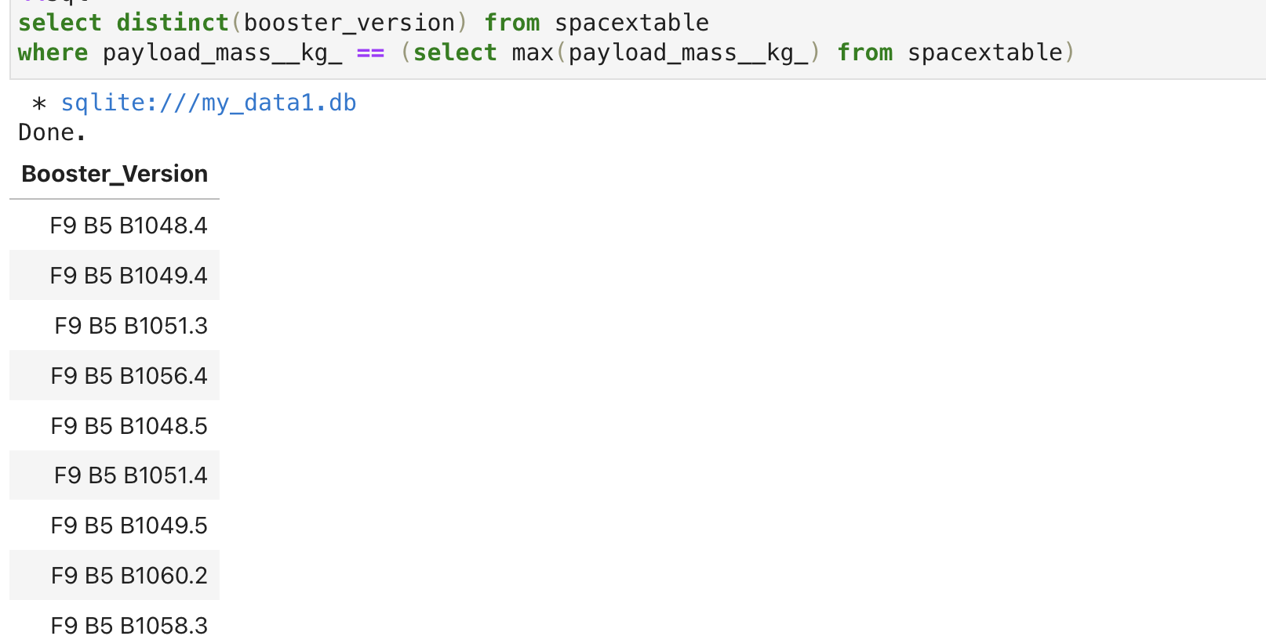
EDA and SQL:
SQL is useful thing. It helps us more understand data and answer some questions.
For example, here we observe total number of successful/failure mission outcomes and which booster version caried maximum payload mass

Slide 11
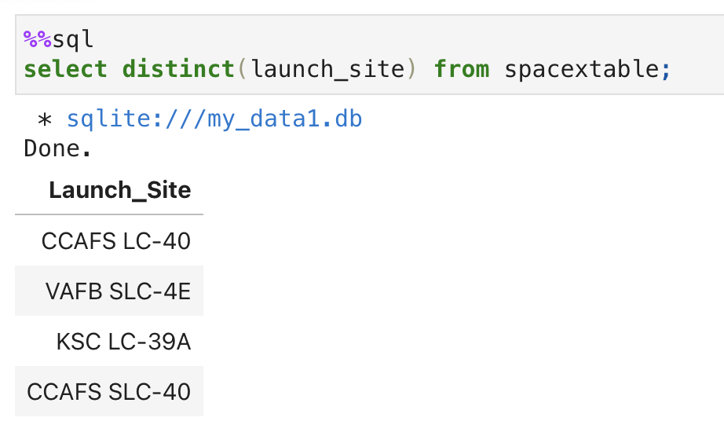
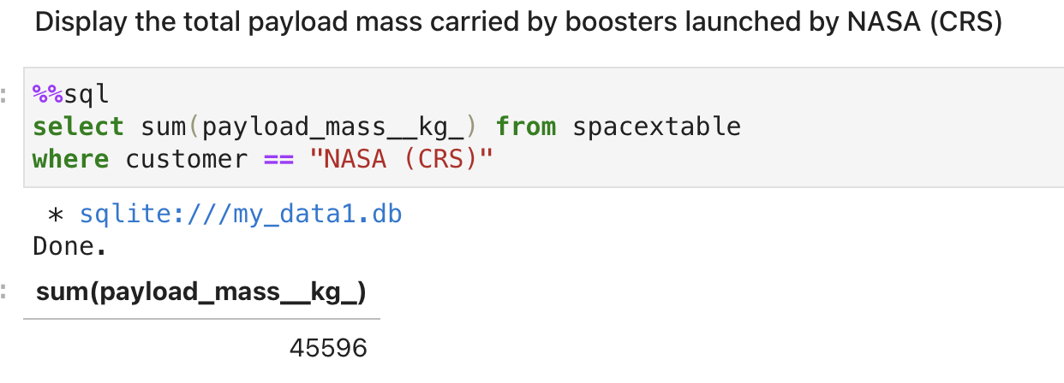

Slide 12
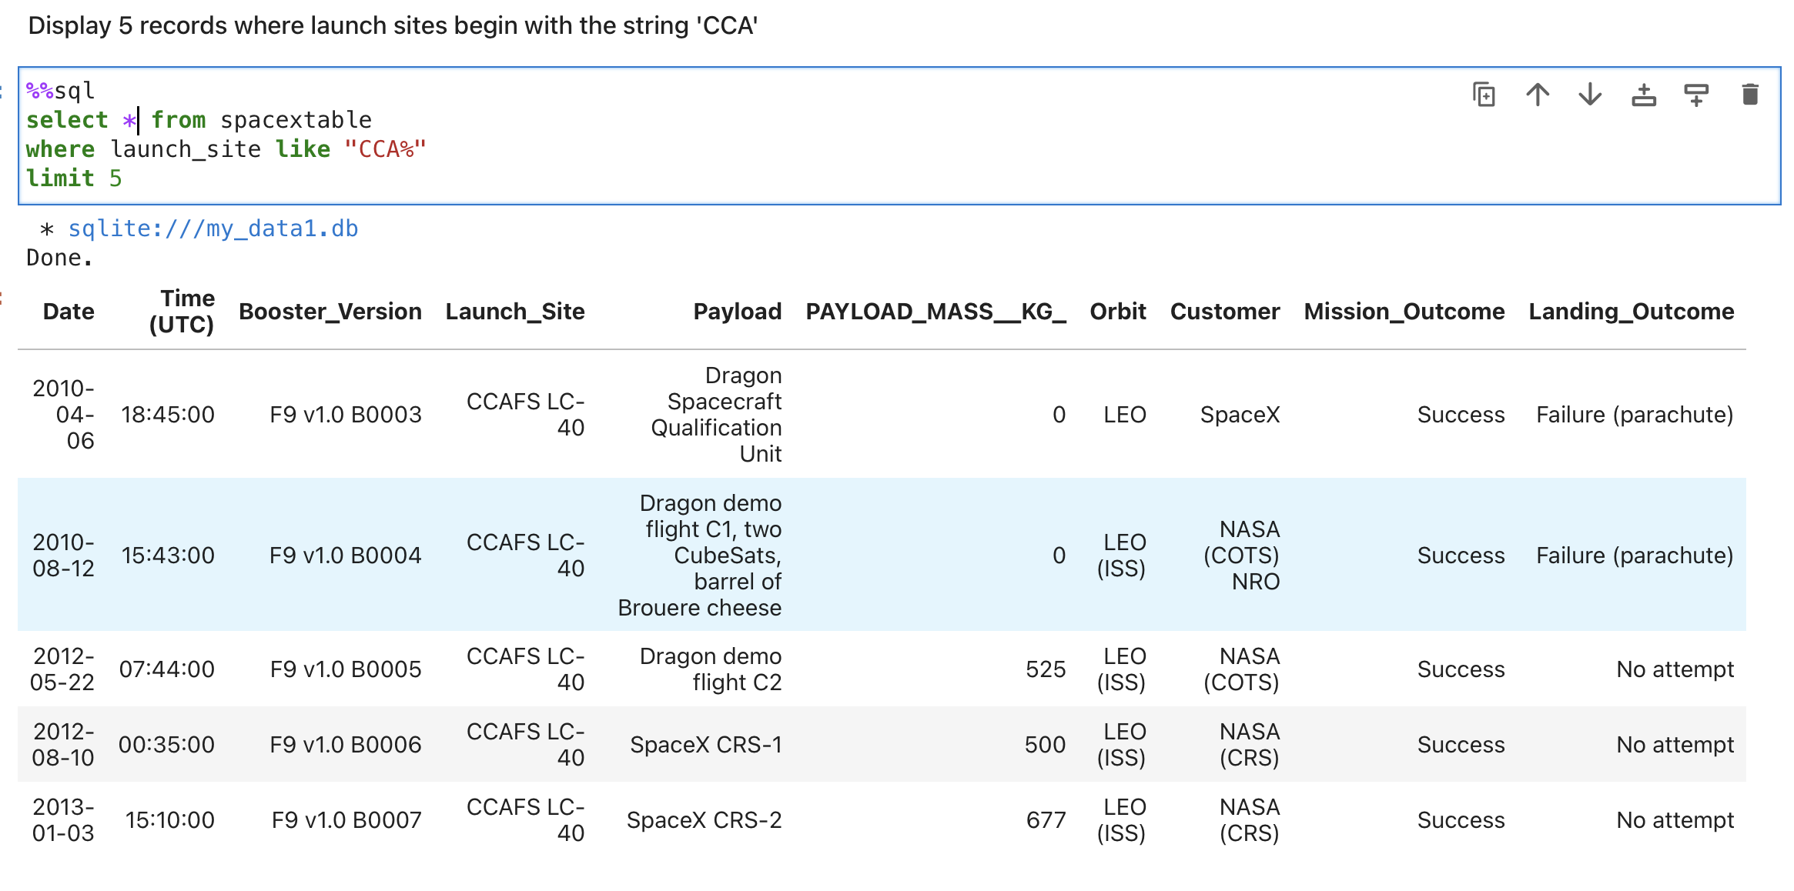

Slide 13
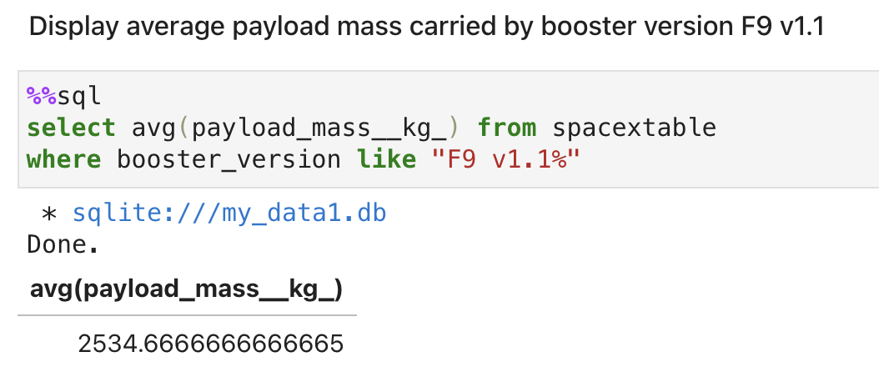
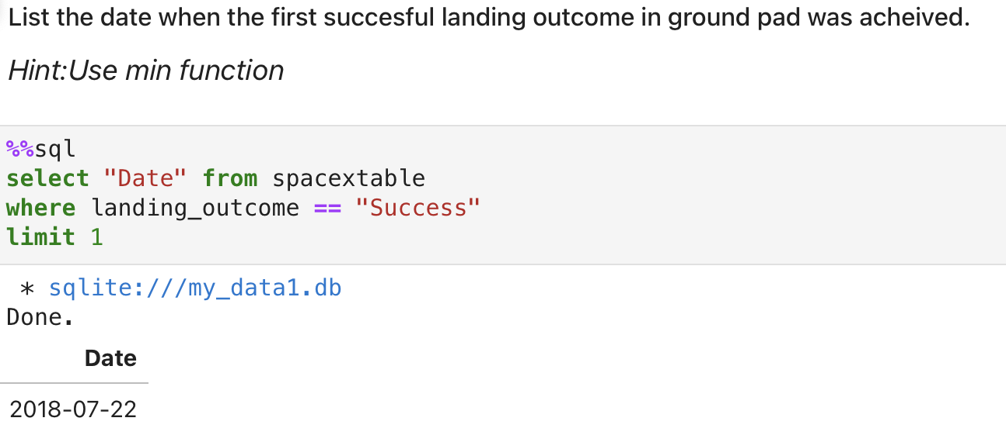

Slide 14
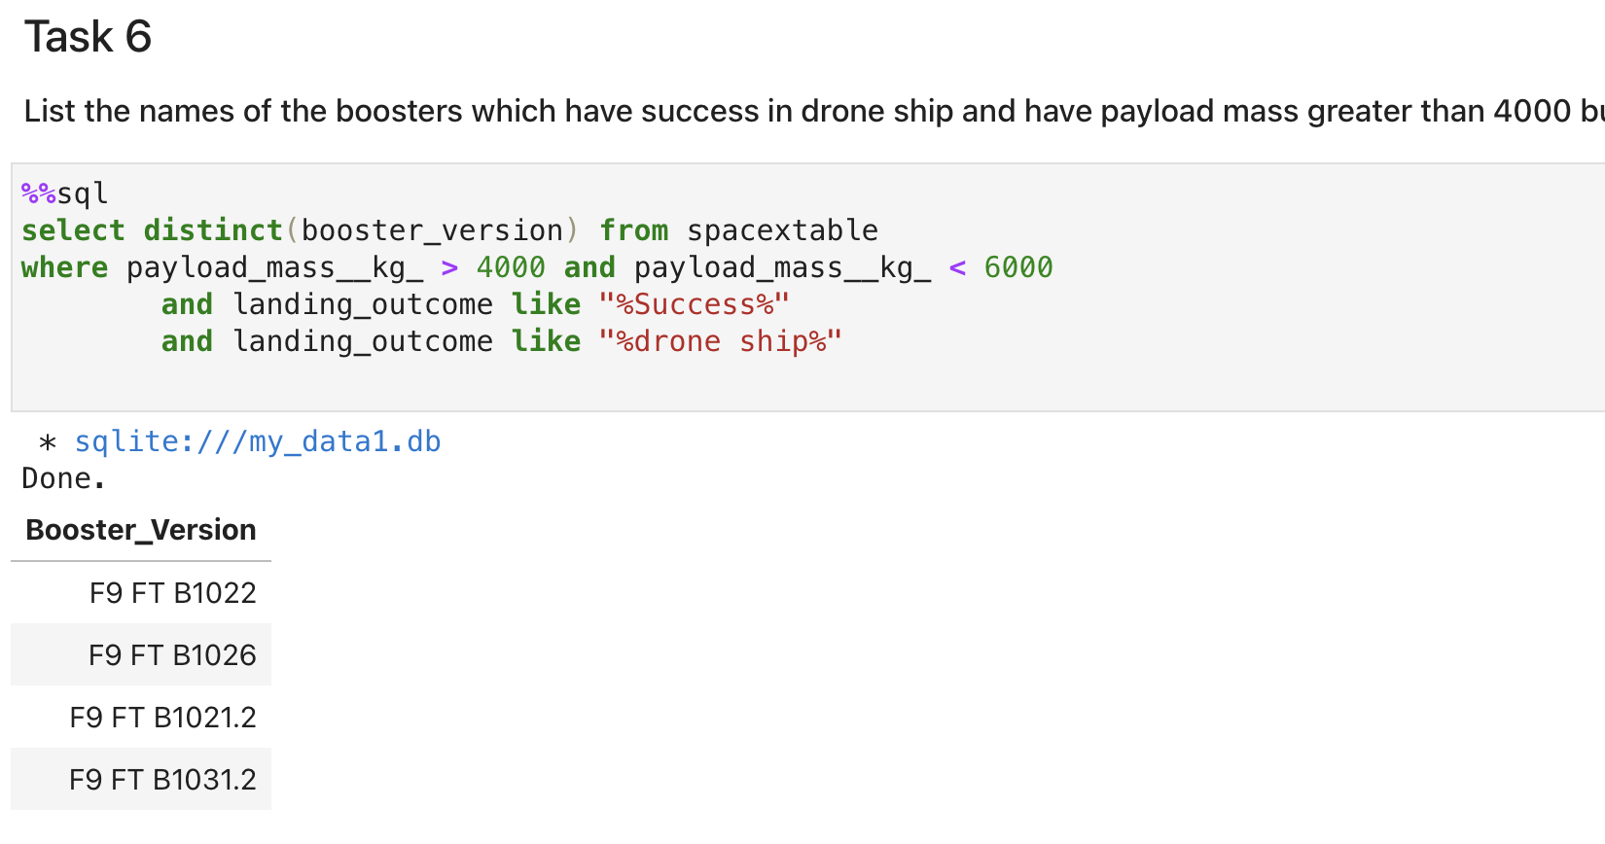

Slide 15
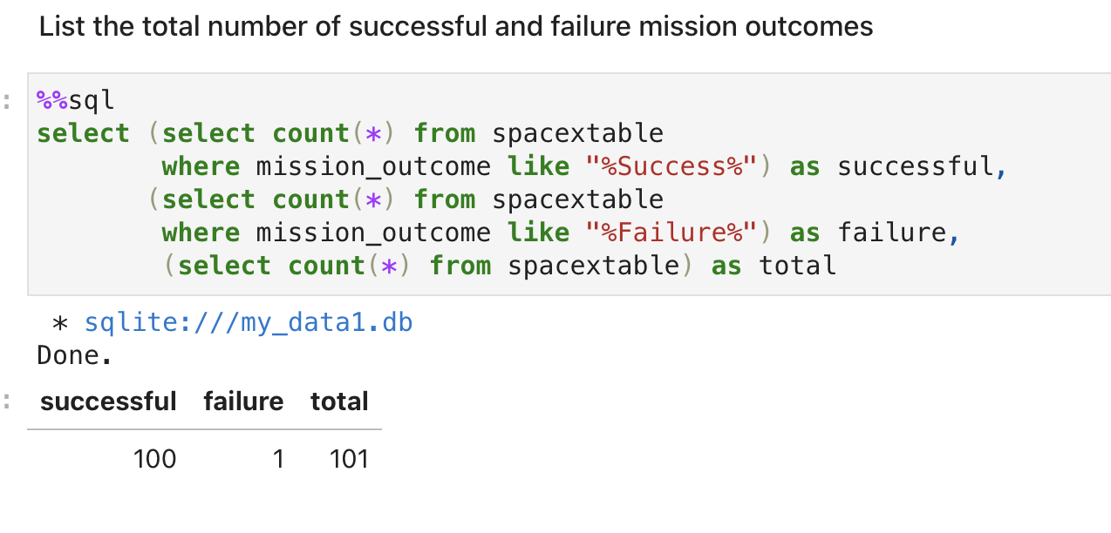

Slide 16
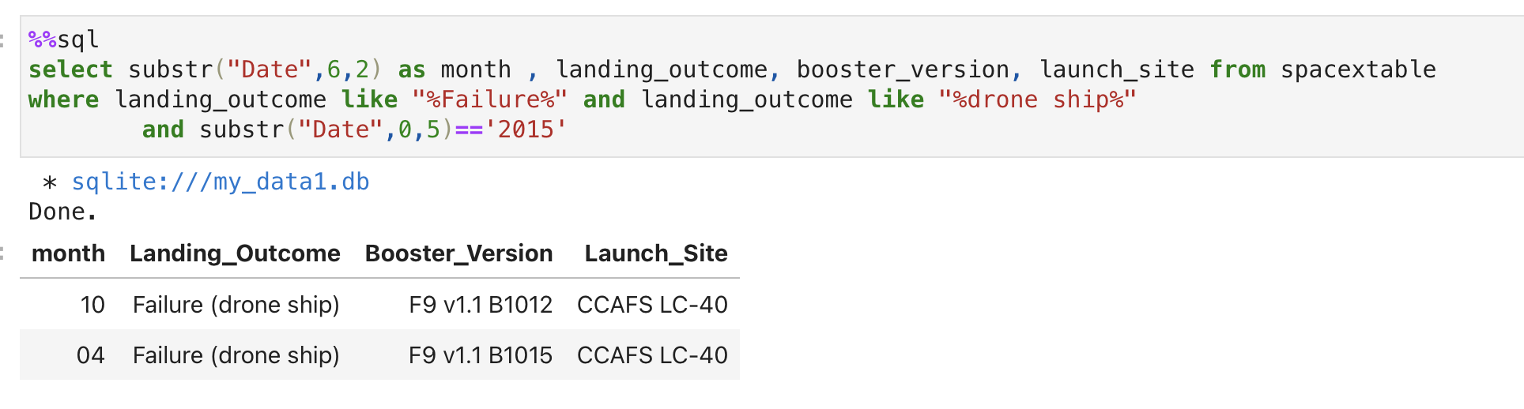
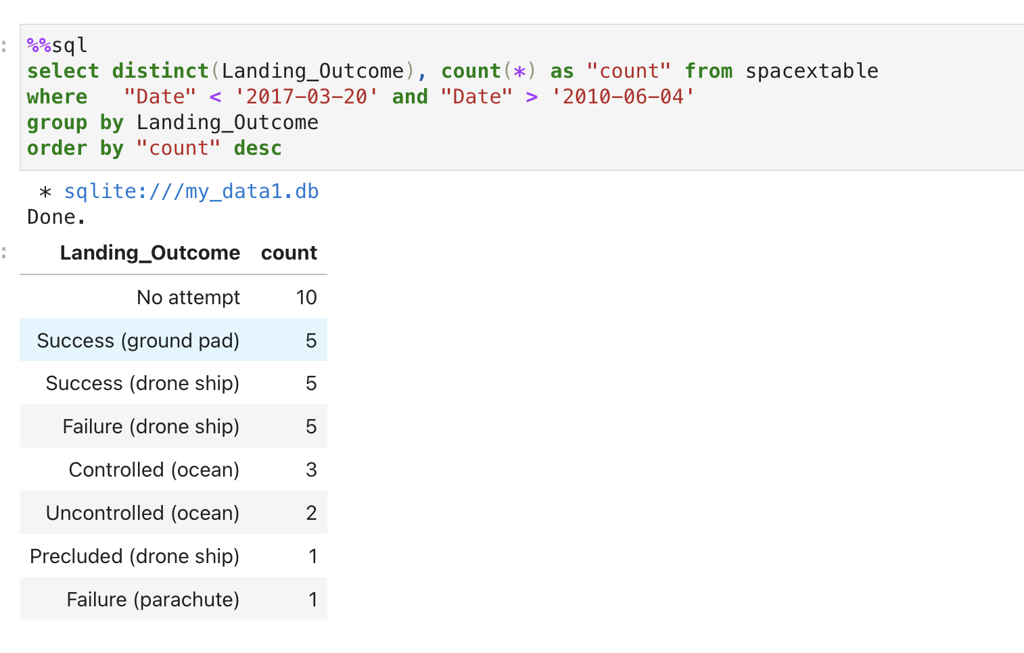

Slide 17
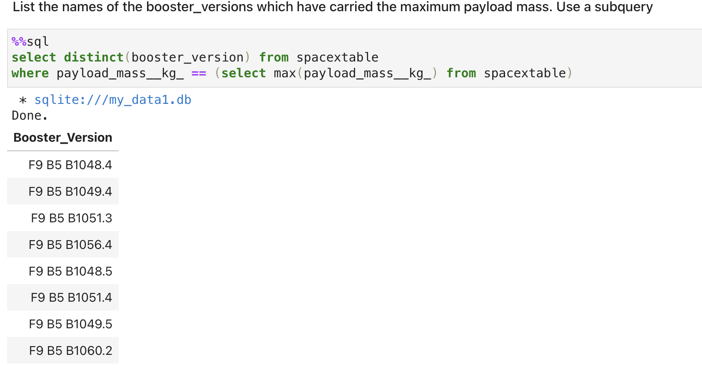

Slide 18
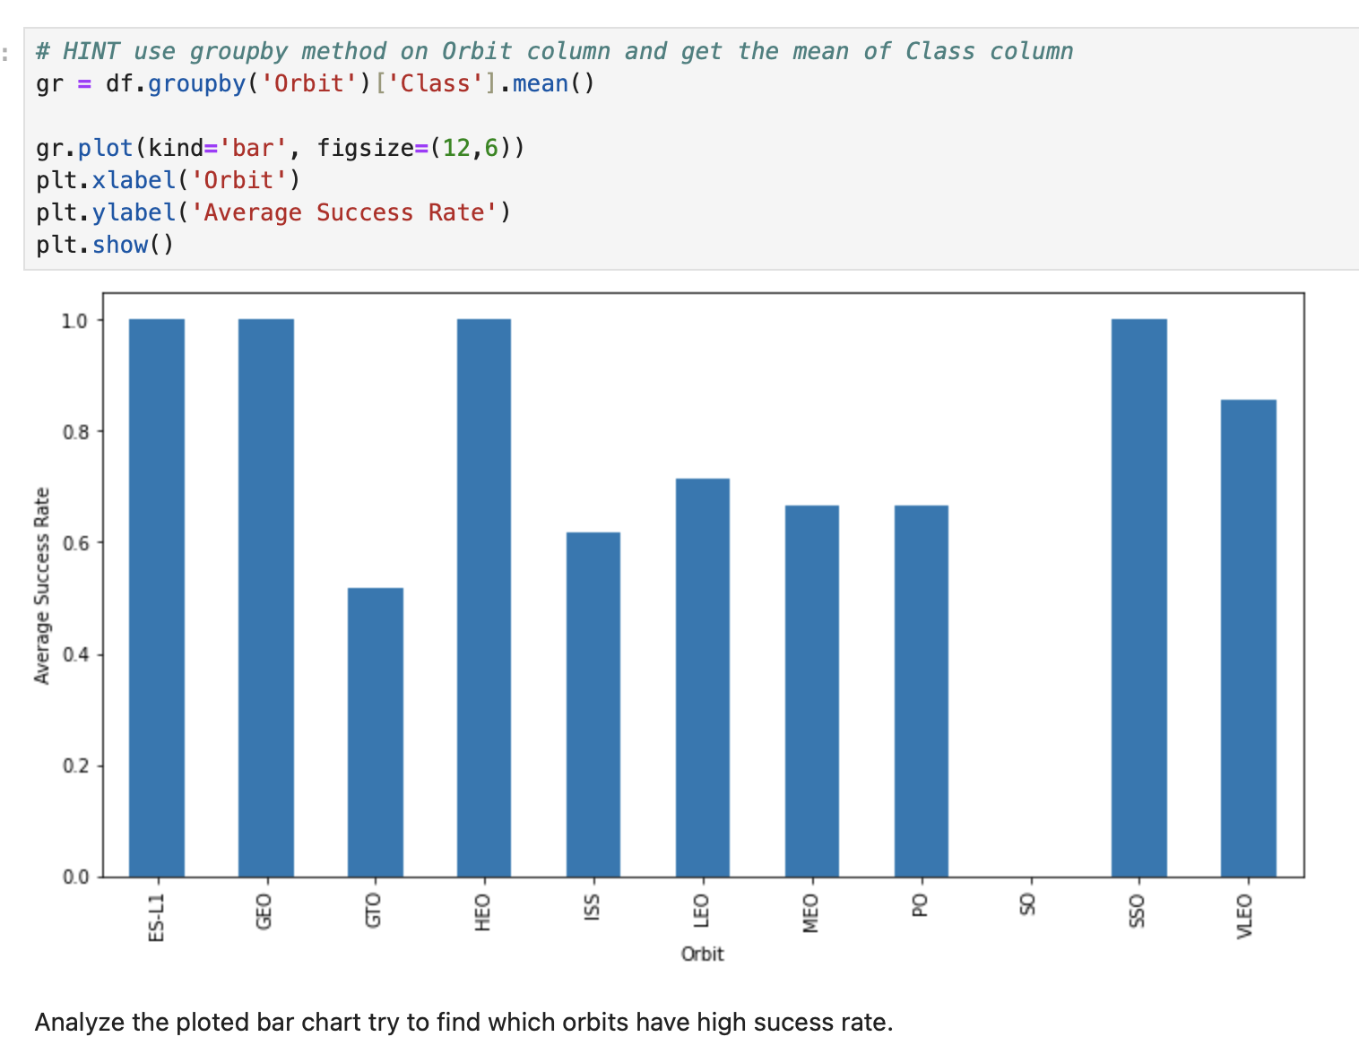
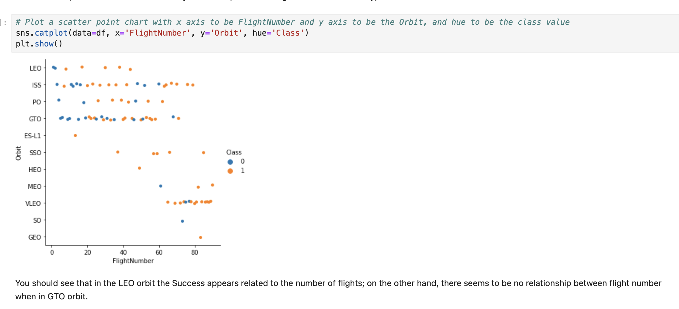
Eda and visualization

Slide 19
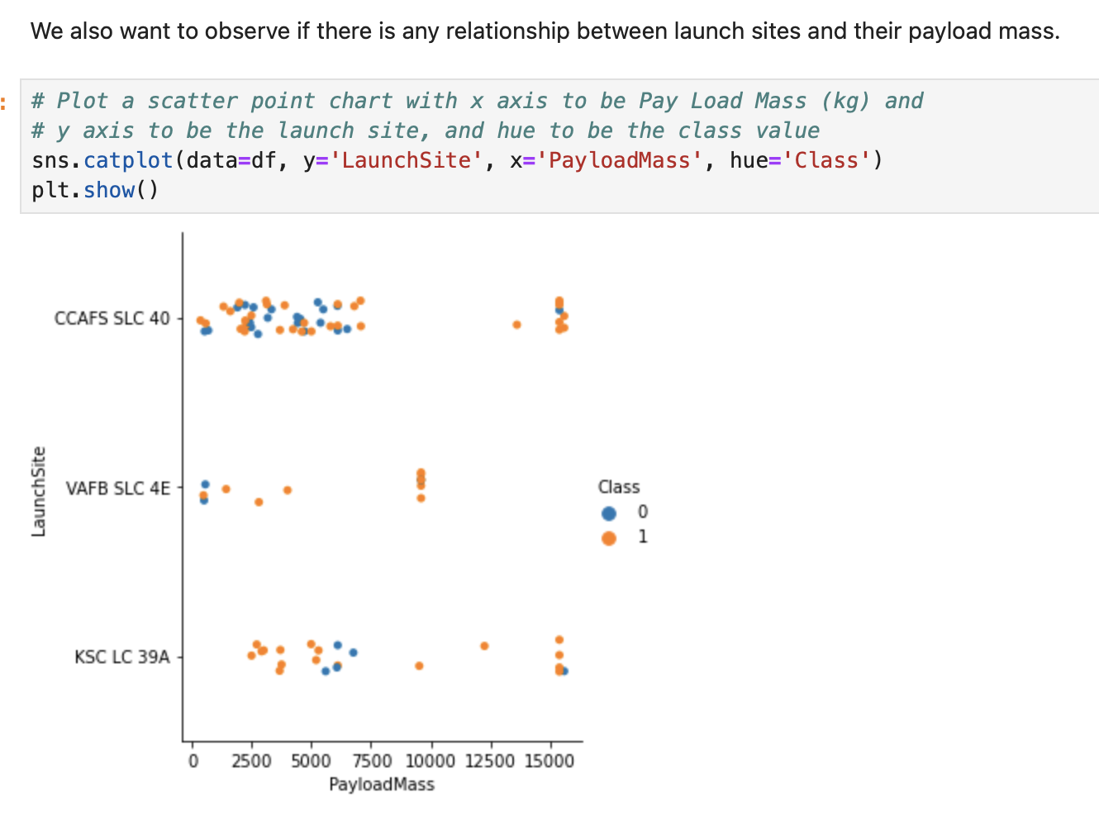
USING EDA WE CAN ANSWER:
With what weight are the missions success?
(between 9000 and 13000 kg)

Slide 20
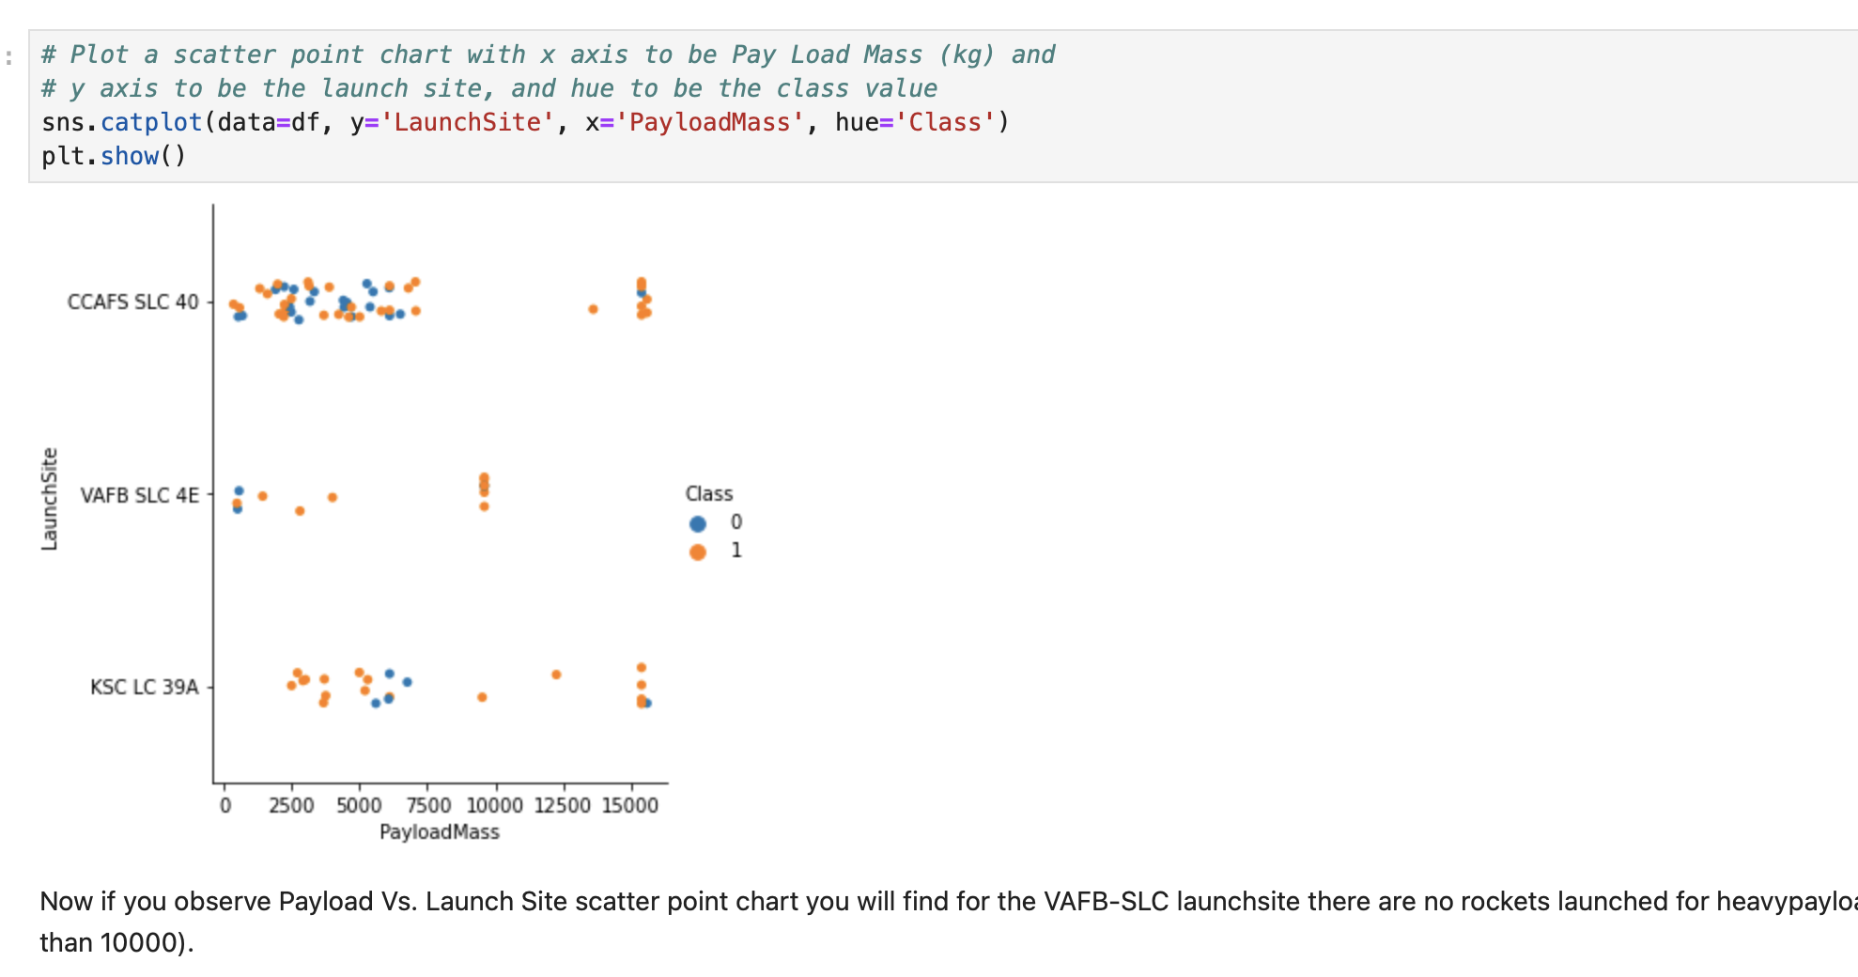

Slide 21
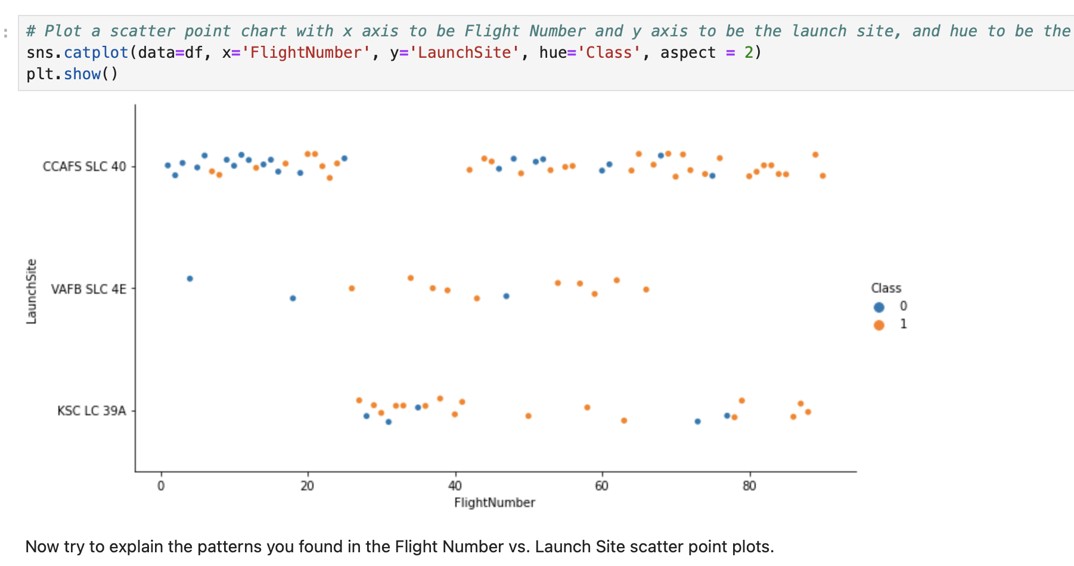

Slide 22
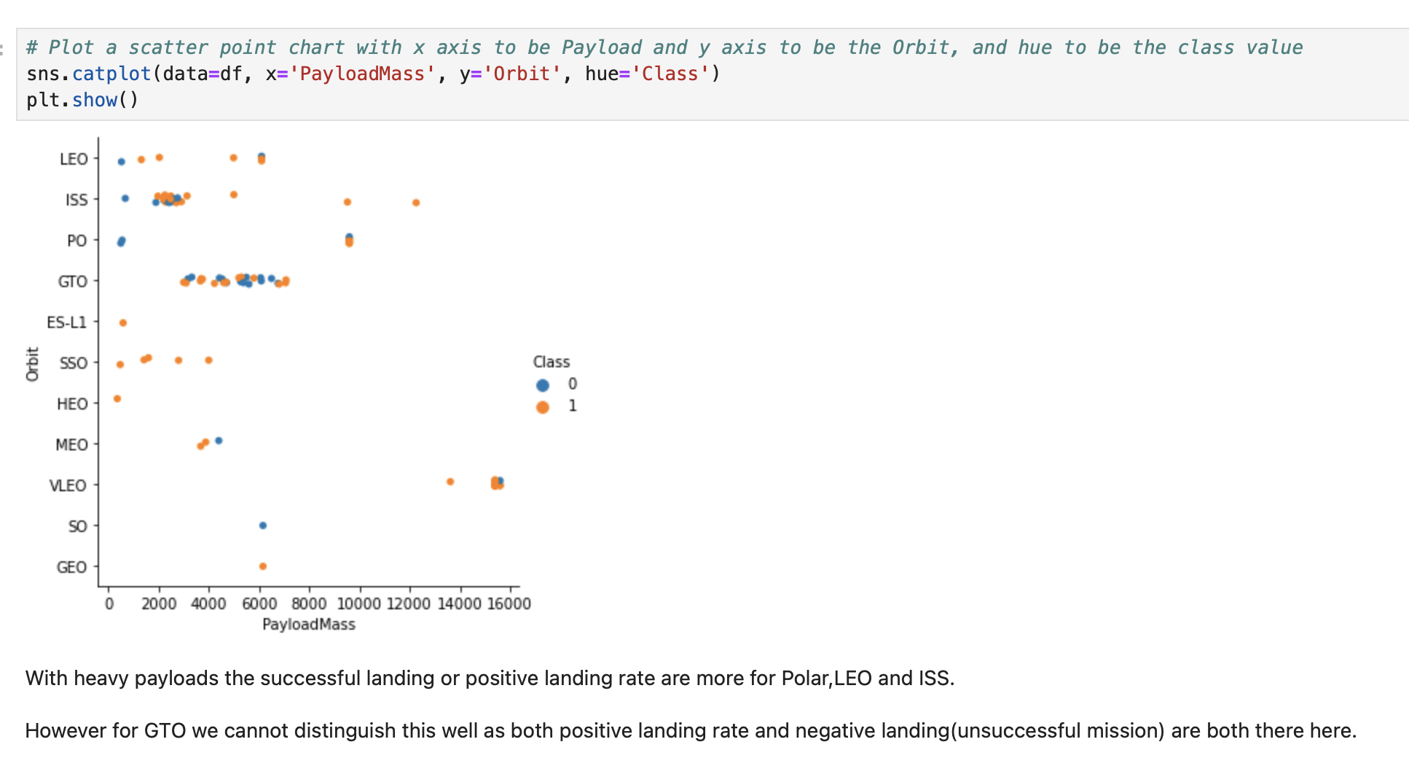

Slide 23
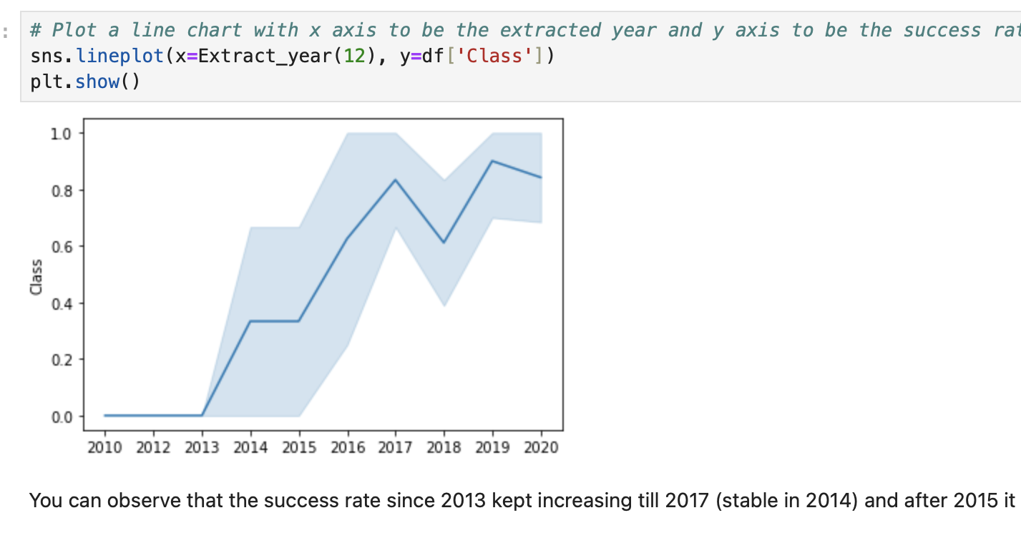

Slide 24
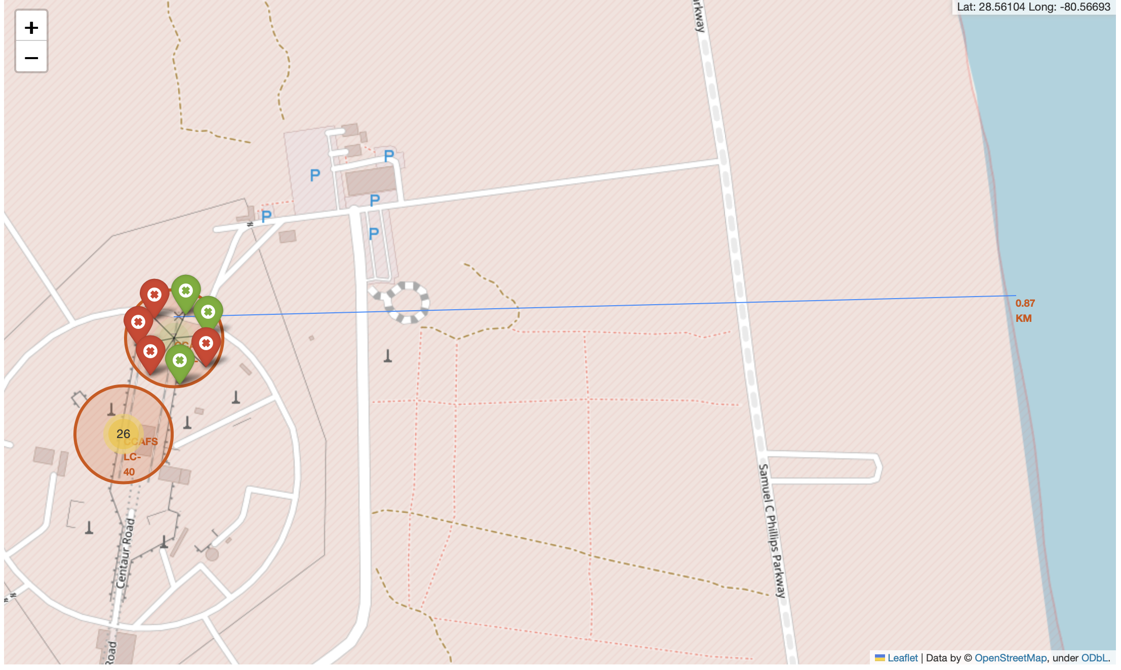
EDA and interactive visual analytics
Using Folium library we can display all launches on map and view info about launhces
For example later we could use this info and add info from meteorological sensors to answer more difficult questions

Slide 25
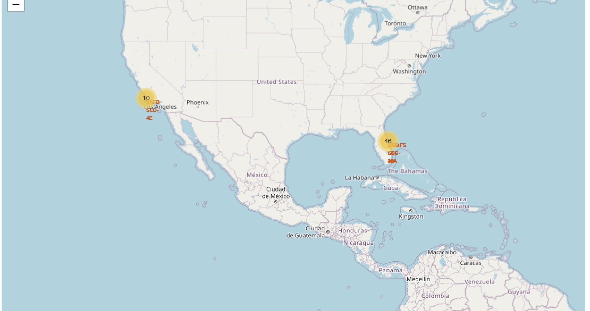
Using Folium we can mark all Launch Sites and provide some info about those Sites

Slide 26
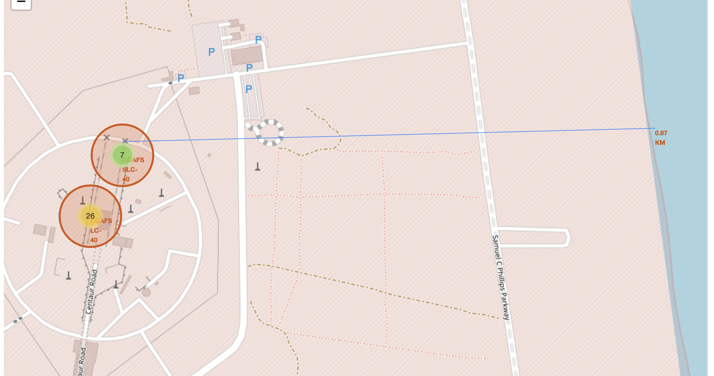
Using Folium we can display how far from launch is coastline

Slide 27
EDA and interactive visual analytics
Using Dash and Plotly we can create app which could automaticly update data, so we get always fresh data and observe it
Created app can be filtered and people who never do programing can analyse

Slide 28
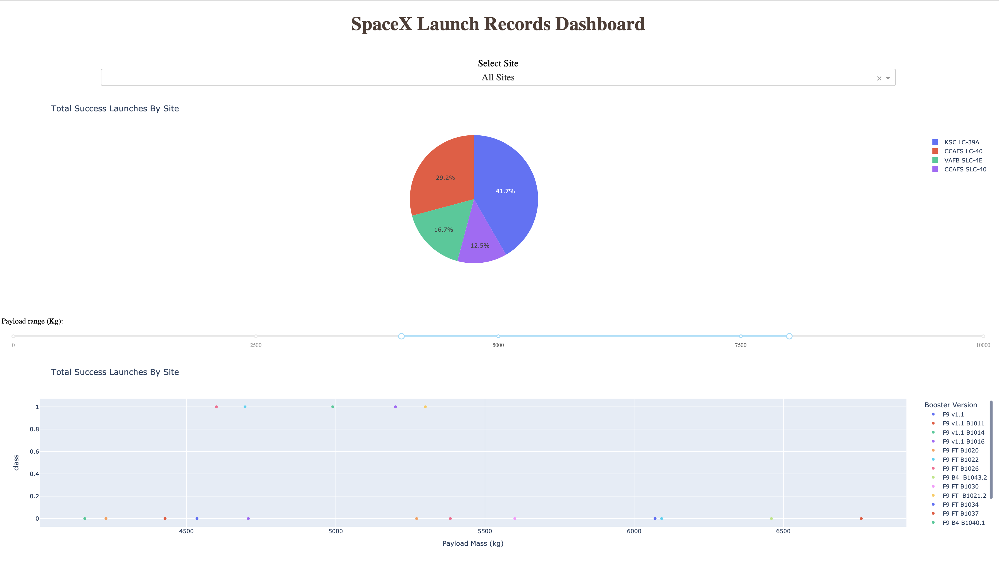
Here we can see pie chart with Total Success by Site, winner is KSL LC-39A
On bottom we can see scatter plot with max payload mass caried by rocket

Slide 29
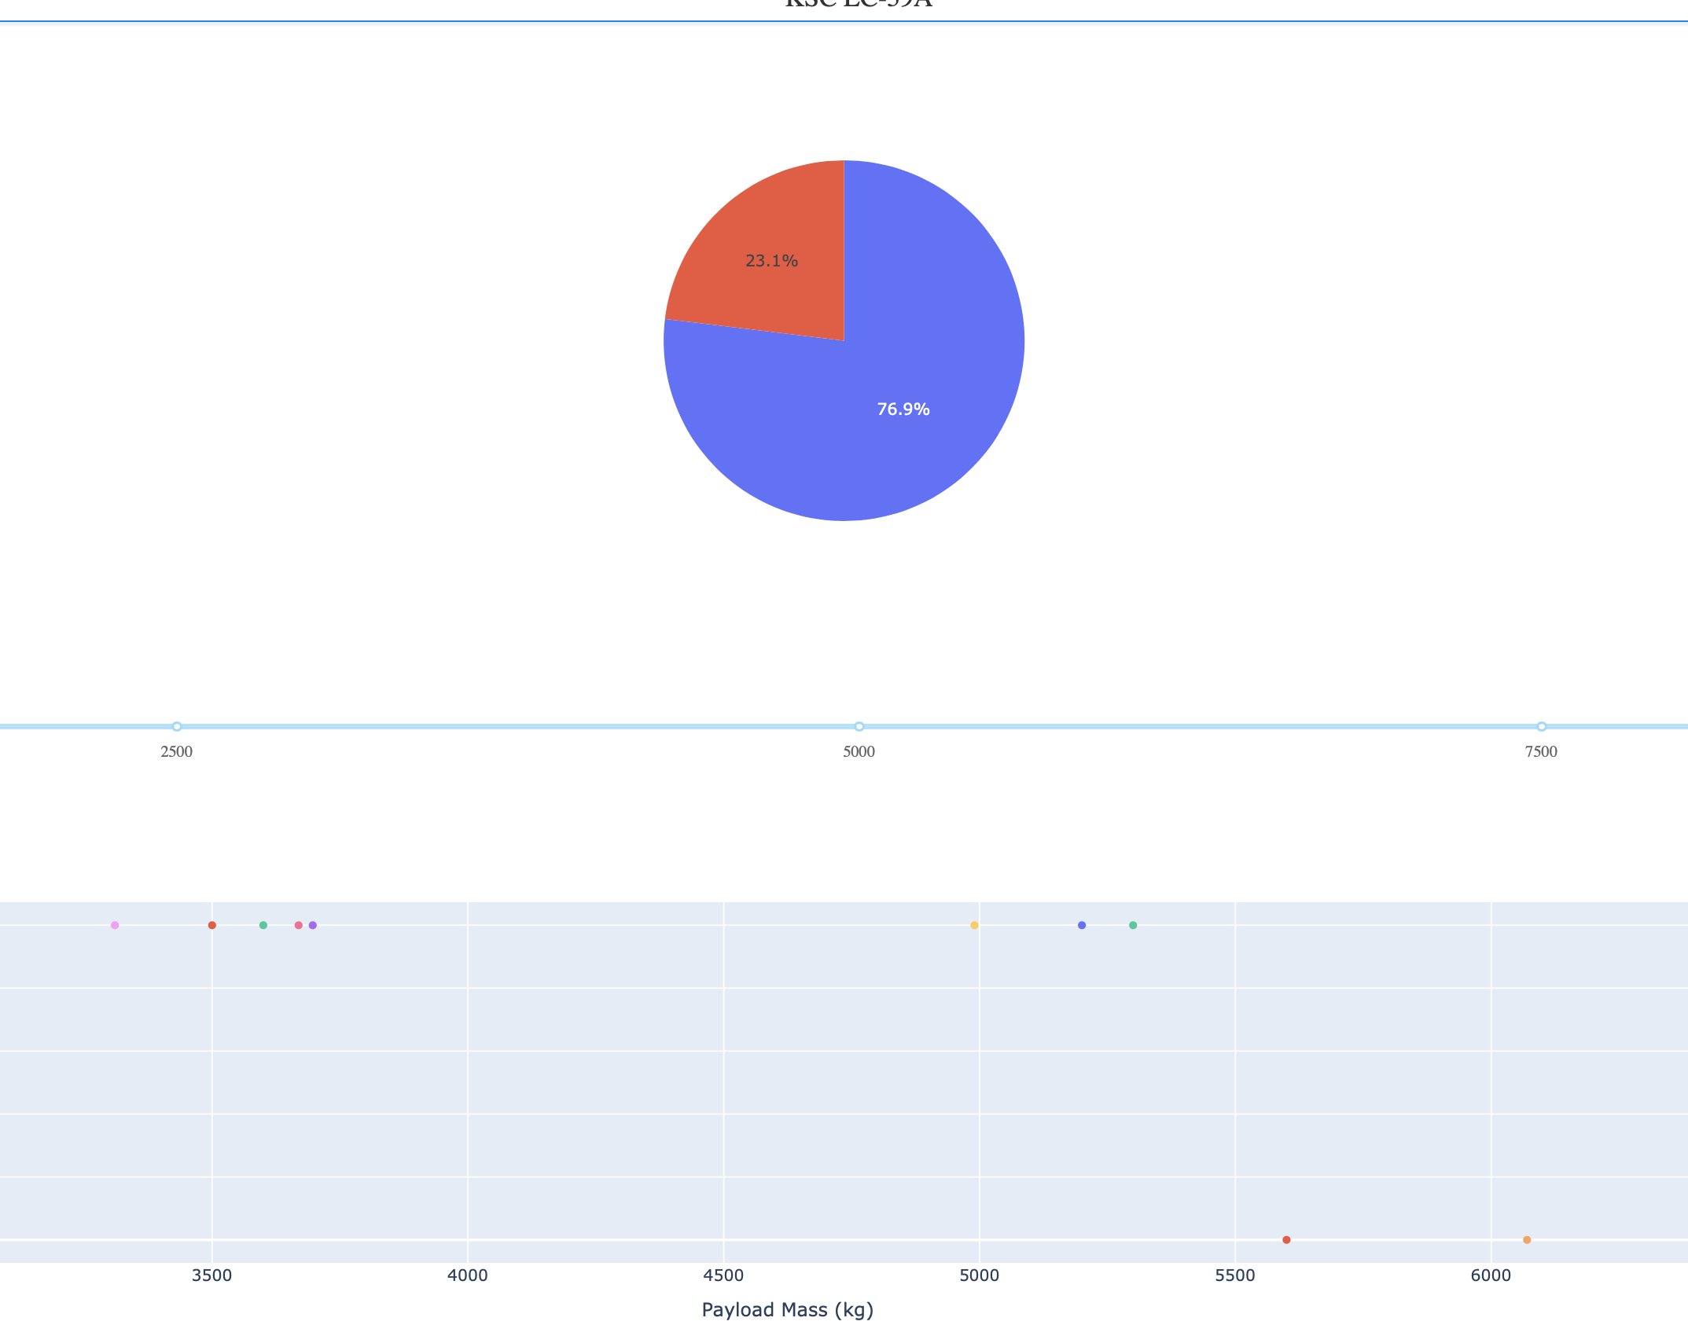
This pie chart shows us best launch site (KSC LC-39A), where 76.9 percent of success launches
On Bottom we can see payload mass caried by rocket

Slide 30
Predictive Analysis methodology:
As always split dataframe into fetures set (X) and label set (Y)
As always use train_test_split to split datasets into training sets and test sets
Will first stage land or not = boolean = Categorical => we will use DecisionTreeClassification, SVC (SVM), LogisticRegression, KNN
For creating models we will apply almost every hyperparameters and for searching best hyperparameters use GridSearchCV
We will use .score function, confusion matrix, roc-curve, auc for compating models

Slide 31
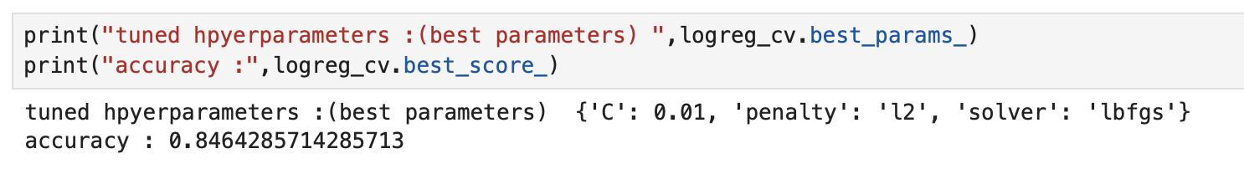
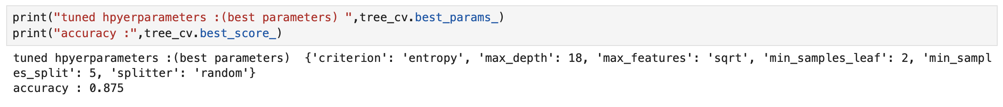
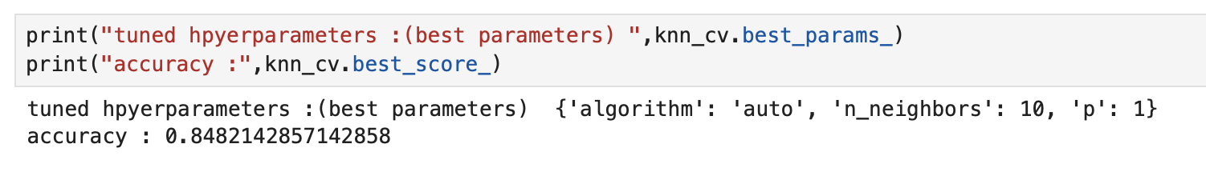
Best Hyperparameters
Logistic Regression
SVC (SVM)
DecisionTreeClassifier
KNN

Slide 32
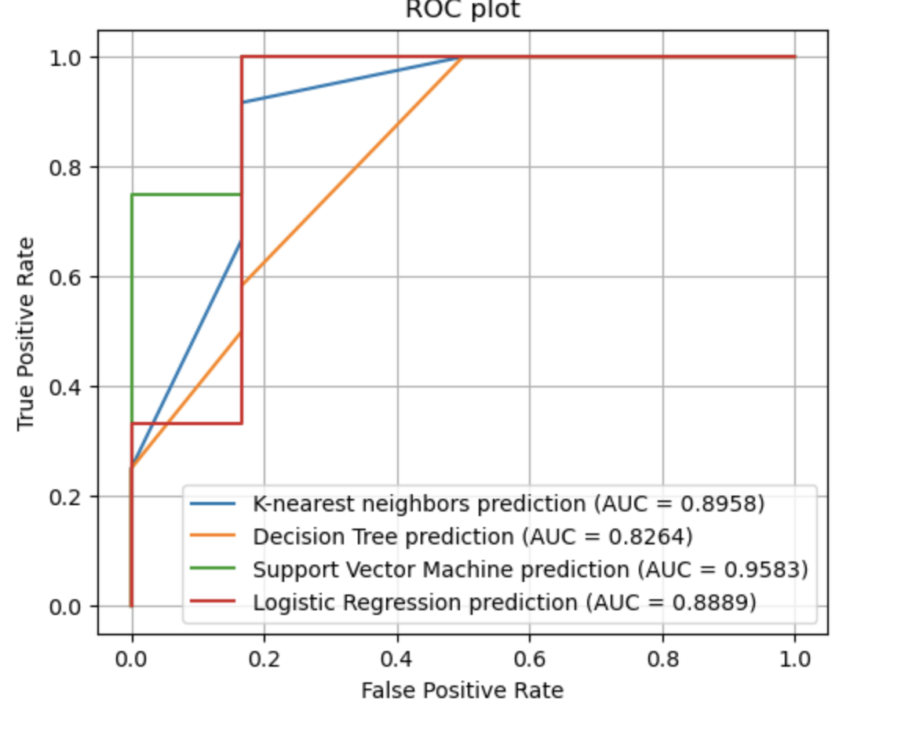
Roc- Curve

Slide 33

Funny Things:
Accuracy score on test set = 83.333333….. Every madel!
Confusion Matrix is same for every model

Slide 34
Conclusions
Now we have working model for predicting will first stage land successfully or not depend on characteristics of rocket

